Slide 1

High-performance
3D applications in Delphi

Slide 2



Yuriy Kotsarenko
R&D Consulting
ykot@afterwarp.io
http://afterwarp.io
Developer of Asphyre / Platform eXtended Library:
http://asphyre.net

Slide 3
Afterwarp framework: Agenda
Introduction
Review key features
Discuss architecture
Walk though example code

Slide 4
Framework: quick facts
Supports Modern Hardware
  Direct3D 11+ and OpenGL 3.3+ (up to 4.6)
    Vulkan: under investigation
  Windows Vista, 7, 8, 8.1 and 10, other OSes.
Need to target Windows XP? No problem!
  Direct3D 9 and OpenGL 2.x (“legacy build”)
  Windows XP, Vista, 7, 8, 8.1 and 10 , other OSes.
Cross-platform
  Windows, Linux, OS X, Android, iOS, Raspberry PI…

Slide 5
Framework: quick facts
Hardware API abstraction
  Fully API and platform agnostic
Low-level easy to use API
  Build your own engine.
  Write your own shaders.
High-level InnerFlux© rendering engine
  Create fast 3D applications quickly and easily.
  Shader or low-level API knowledge not required.

Slide 6
Framework: quick facts
Core framework is written in C++
  Features from latest C++17 standard
  Highly optimized and reliable
High-level Delphi Framework built on top
  Full native Delphi vector, color and math library
  Thin wrapper that gets inlined by Delphi compiler
    Zero overhead, maximum performance
  Friendly and easy-to-use high-level objects
  Supports from Delphi 2006 to Delphi Tokyo 10.2.3
    Delphi 7 and earlier support coming for those who need it…

Slide 7
Framework: 3D Features
Hybrid Deferred-Forward multi-stage rendering
Real-time Shadows with Soft Penumbra
Order-Independent Transparency
3D Volume Surface visualization
  Geometry generation directly on GPU
3D Graphing and Object-Model Hierarchy

Slide 8
Framework: Text Features
High-quality antialiasing with sub-pixel accuracy
Unicode support
Color gradients, border, shadow, outline, blending effects
SDF Text with up to 16x super-sampling
  Superior quality of 3D “vector-like” text

Slide 9
Framework: 2D features
Geometric shapes
  Varying thickness, color gradients, blending effects
Arbitrary paths with multiple options for joints and caps
Polygons of any kind (including holes)
Cubic interpolation for images
Signed-distance Fields (“vector-like” images)

Slide 10
Framework: Feature facts
Geometry and Compute shaders
  Generate complex 3D scenes directly on GPU
  General-purpose massively parallel computing
Inherent HiDPI support (any scale)
Enterprise features for CAD applications
  Object, camera, viewport manipulation
  3D hierarchy model, object picking with mouse
Support for industry 2D and 3D formats

Slide 11
Architecture
Delphi Application
High-level Wrapper
Color, vector and math framework
Library API
Platform API
GPU

Slide 12
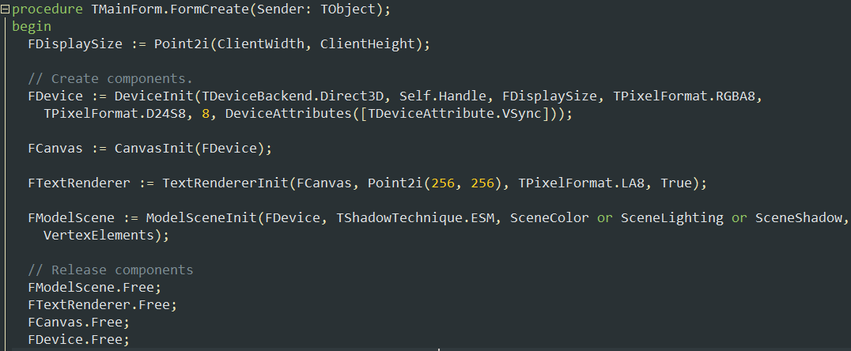
Example usage

Slide 13
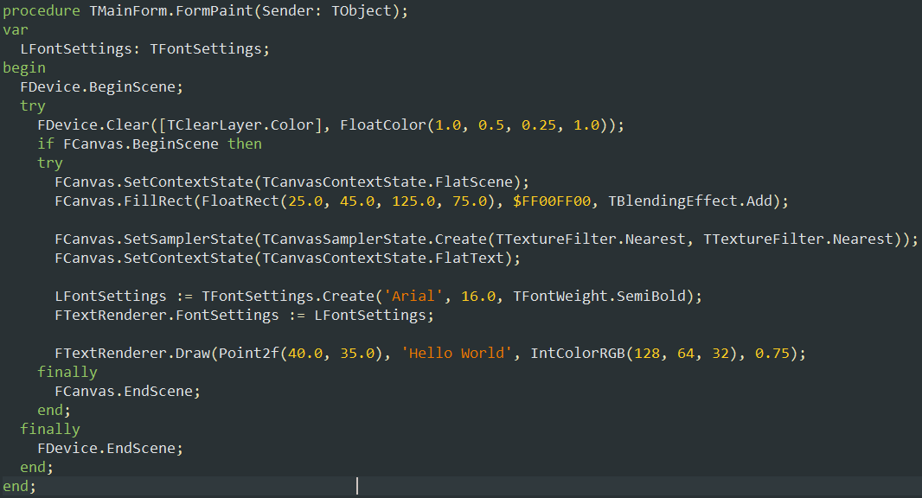

Slide 14

Zero call overhead

Slide 15
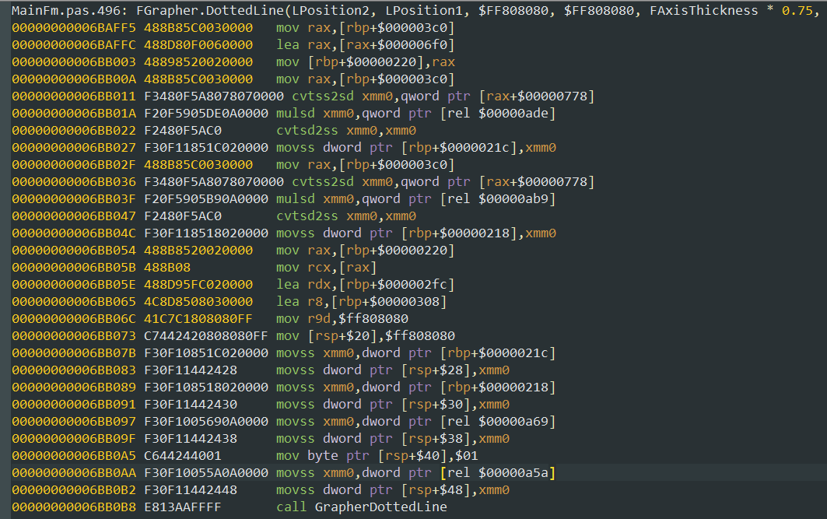

Slide 16
Using the framework
Let’s open some example projects!

