Slide 1






Bruno Fierens
info@tmssoftware.com
Follow us
TMS RADical WEB : TMS WEB Core intro
facebook.com/tmssoftware @tmssoftwarenews @BrunoFierens
youtube.com/tmssoftwareTV

Slide 2



TMS RADical WEB : TMS WEB Core intro
You could use the Pascal language to program for the browser …

Slide 3
TMS RADical WEB : TMS WEB Core intro
You could use a RAD component framework and full OO to create browser applications

Slide 4
TMS RADical WEB : TMS WEB Core intro
You could do all this from the Delphi IDE

Slide 5
TMS RADical WEB : TMS WEB Core intro
You could reuse not only your knowledge of developing VCL or FMX applications but also reuse components (FNC) between the VCL and FMX applications and your browser applications
FNC = Framework Neutral Components

Slide 6
TMS RADical WEB : TMS WEB Core intro
You could take advantage of all latest & greatest HTML/CSS in the browser and also mix with Javascript code/libraries when needed

Slide 7
TMS RADical WEB : TMS WEB Core intro
You could easily & effortlessly deploy your browser applications to any industry standards webserver

Slide 8
TMS RADical WEB : TMS WEB Core intro
You could make seamless use of cloud data & services via standard REST

Slide 9
TMS RADical WEB : TMS WEB Core intro
A product like this existed for Delphi developers ….

Slide 10
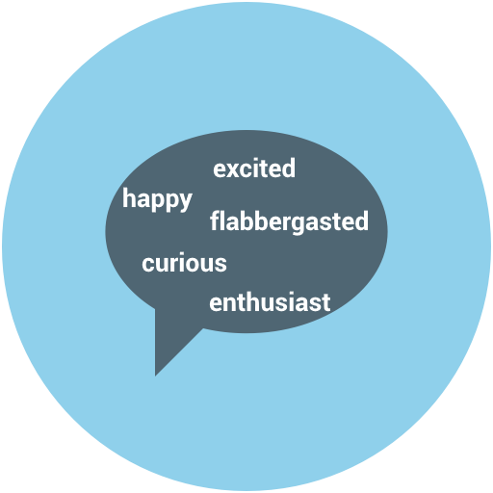

TMS RADical WEB : TMS WEB Core intro
Are you …

Slide 11


TMS RADical WEB : TMS WEB Core intro
We present:

Slide 12
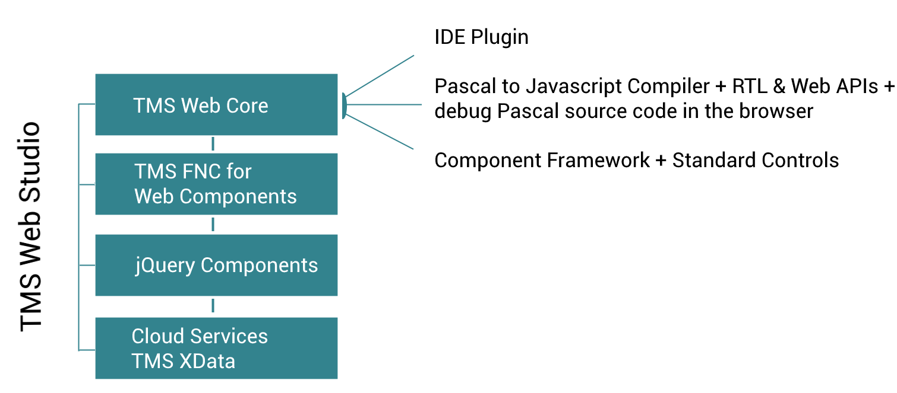
TMS RADical WEB : TMS WEB Core intro
What is it?

Slide 13
TMS RADical WEB : TMS WEB Core intro
What is it?
Delphi IDE plugin
Pascal to Javascript compiler
Standard controls framework (TEdit, TButton, TListBox, …)
FNC for the Web
jQuery control wrappers
Seamless consuming of REST cloud services
Seamless databinding to cloud DB via REST (TMS XData)

Slide 14
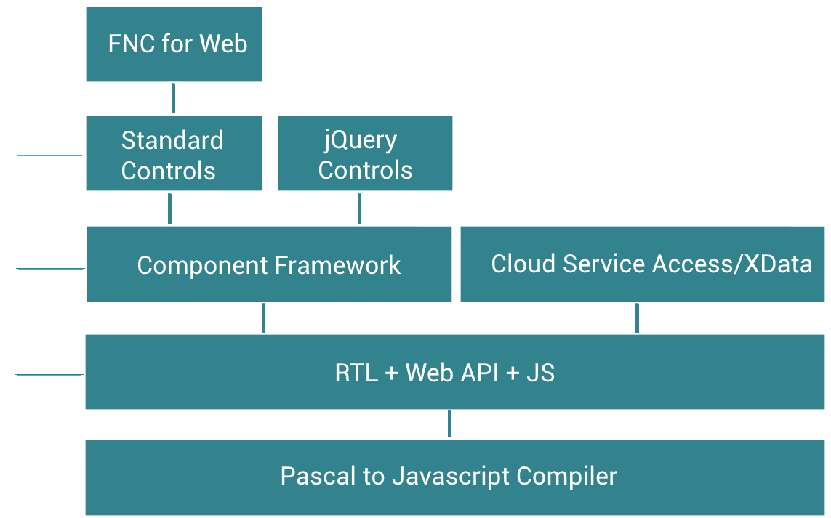



TMS RADical WEB : TMS WEB Core intro
Architecture
IDE
…

Slide 15
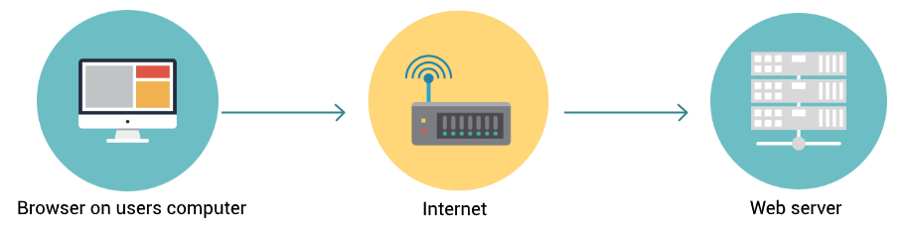
TMS RADical WEB : TMS WEB Core intro
How does it work?
Delphi solutions in the past:
HTTP GET/POST
Server application with session management + DB connection
generating pages
HTML/JS/CSS

Slide 16
TMS RADical WEB : TMS WEB Core intro
How does it work?
„Modern“ web apps:
HTML/JS/CSS
Fileserver: HTML/CSS/JS
JS Application
REST service endpoints
(microservices)
JSON HTTP REQ

Slide 17
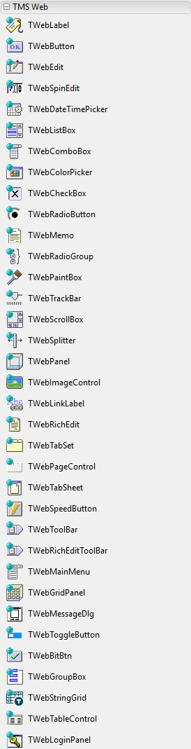
TMS RADical WEB : TMS WEB Core intro
Framework: Basic controls
Basic controls: TWebForm, TWebEdit, TWebButton, …
Pascal wrapper classes for HTML elements BODY, INPUT, BUTTON, …
Pascal class properties map on HTML element attributes, CSS style properties
HTML element Javascript events mapped on Pascal class events
Pascal class interface as close as possible to VCL control equivalents
Possibility to specify CSS class(es) for HTML elements

Slide 18
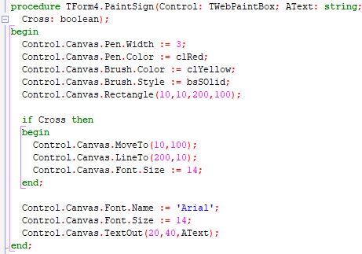
TMS RADical WEB : TMS WEB Core intro
Framework: TCustomControl
Pascal control class mapped on a HTML5 CANVAS element
Pascal TCanvas class mapped on HTML5 CANVAS graphic context
VCL TCanvas interface compatible class
Javascript mouse & keyboard events mapped on
virtual methods with identical signature to VCL controls
(Key*, Mouse* methods)
Example: TWebPaintBox

Slide 19
TMS RADical WEB : TMS WEB Core intro
Framework: control creation
By Pascal class creating HTML element via document.createElement()
By Pascal class referencing an existing HTML element specified in HTML template via the HTML element ID

Slide 20
TMS RADical WEB : TMS WEB Core intro
Framework: control positioning
Absolute or relative positioning
Absolute or relative size
Position controlled by design-time position/size persisted in DFM file
or
Position controlled by HTML template
Anchoring and aligning as in VCL available

Slide 21
TMS RADical WEB : TMS WEB Core intro
Framework: FNC controls
Entire FNC framework interface was mapped onto standard HTML elements
Control code against this FNC interface works in VCL, FMX, LCL and now also web applications
One code base for your UI !
TMS FNC UI Pack, TMS FNC Chart, TMS FNC Dashboard Pack controls are now web-enabled

Slide 22
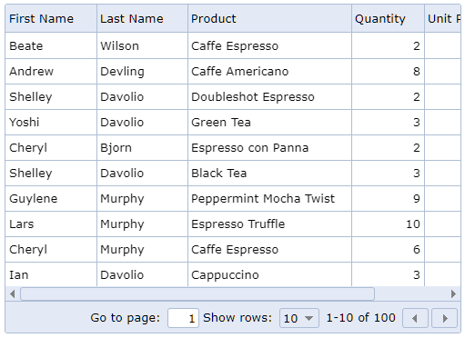
TMS RADical WEB : TMS WEB Core intro
Framework: jQuery controls
Similar to mapping a Pascal class on a HTML element but now on a (complex) jQuery control
Map jQuery control attributes on Pascal class properties and jQuery control events to Pascal class events
Working to cover entire www.jqwidgets.com jQuery UI controls collection

Slide 23
TMS RADical WEB : TMS WEB Core intro
Framework: client dataset
Web client dataset with interface compatible with Delphi TDataSet
Can be bound to DB-aware controls via DataSource similar to VCL
Includes TWebDBEdit, TWebDBCheckBox, TWebDBMemo, TWebDBNavigator …

Slide 24
TMS RADical WEB : TMS WEB Core intro
Framework: REST
TWebRESTClient (underlying XMLHttpRequest)
Performs HTTP(S) GET, PUT, POST, DELETE requests
Performs REST requests with authorization header

Slide 25
TMS RADical WEB : TMS WEB Core intro
Framework: caveat
Asynchronous behavior!
Image resources <IMG src=“url“> never load synchronously
HTTP requests via Javascript XMLHttpRequest all work asynchronously

Slide 26
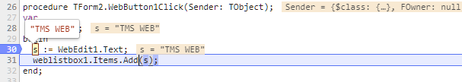
TMS RADical WEB : TMS WEB Core intro
Debugging
Use browser debugger to step through, watch,... Javascript code
Pascal to Javascript compiler can create map files to debug Pascal code via Chrome or Firefox

Slide 27

Q&A

Slide 28
More info: http://web.tmssoftware.com

Slide 29
Bruno Fierens
info@tmssoftware.com
Follow us
TMS RADical WEB : TMS WEB Core in action
facebook.com/tmssoftware @tmssoftwarenews @BrunoFierens
youtube.com/tmssoftwareTV

Slide 30
Demo 1
The basics: Using RAD component framework

Slide 31
Demo 2
Basic Bootstrap demo

Slide 32
Demo 3
RAD + HTML/CSS

Slide 33
Demo 4
Alignment & anchoring

Slide 34
Demo 5
Web RichEditor

Slide 35
Demo 6
Consuming cloud services

Slide 36
Demo 7
FNC Grid for the Web

Slide 37
Demo 8
FNC Planner for the Web

Slide 38
Demo 9
TV Guide with FNC Planner

Slide 39
Demo 10
FNC Navigation panel
for the Web

Slide 40
Demo 11
Seamless database connectivity

Slide 41
Demo 12
Multiform handling

Slide 42
Demo 13
jQuery

Slide 43
Demo 14
Embedding web controls

Slide 44
Demo 15
What is brewing in the lab …

Slide 45
TMS RADical WEB : TMS WEB Core intro
Many thanks to:
Mattias Gärtner: Compiler
Michael Van Canneyt: Compiler + RTL
Pieter Scheldeman: FNC for the Web
Bart Holvoet: Control Framework + Standard Controls
Roman Kassebaum: IDE Integration
Wagner Landgraf: XData Integration
Holger Flick: Evangelist + QA
Leon Kassebaum: ideas & energy from the next gen!
Detlef Overbeek: Inspiration, Motivation, Out of the box thinking

Slide 46
Q&A

Slide 47
More info: http://web.tmssoftware.com

